Slide 1
T11
Avionics QDR
9/30/2014
Jeremy Feldstein
Brent justice
Nick Eisenhauer

Slide 2
Presentation outline
Avionics System Summary
Eagle Tree Systems Software
Experimental Results

Slide 3
Avionics Summary
The avionics are what we are using to track the RPA airspeed, altitude, and GPS position
Five main parts
Eagle Tree eLogger V4
Eagle Tree Airspeed Microsensor V3
Eagle Tree Altimeter Microsensor V4
Eagle Tree GPS V4
Eagle Tree PowerPanel LCD Display

Slide 4
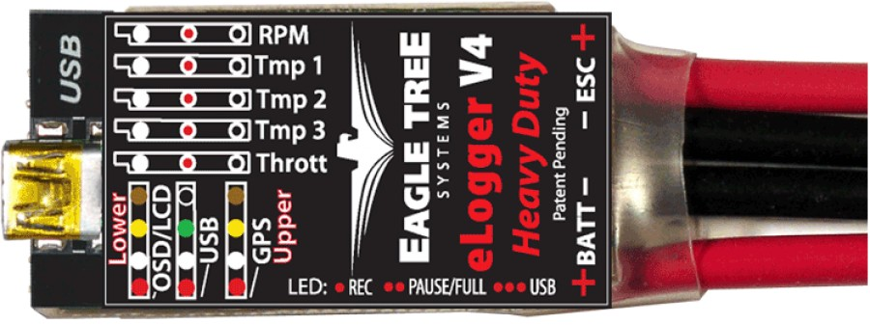
Eagle tree eLogger v4
Data logging system
Connect additional sensors to eLogger to record data during flight.
Logging speed of 50Hz
Logs up to 4 hours of data
0.8 oz, 2.25” x 1” x 0.5”

Slide 5
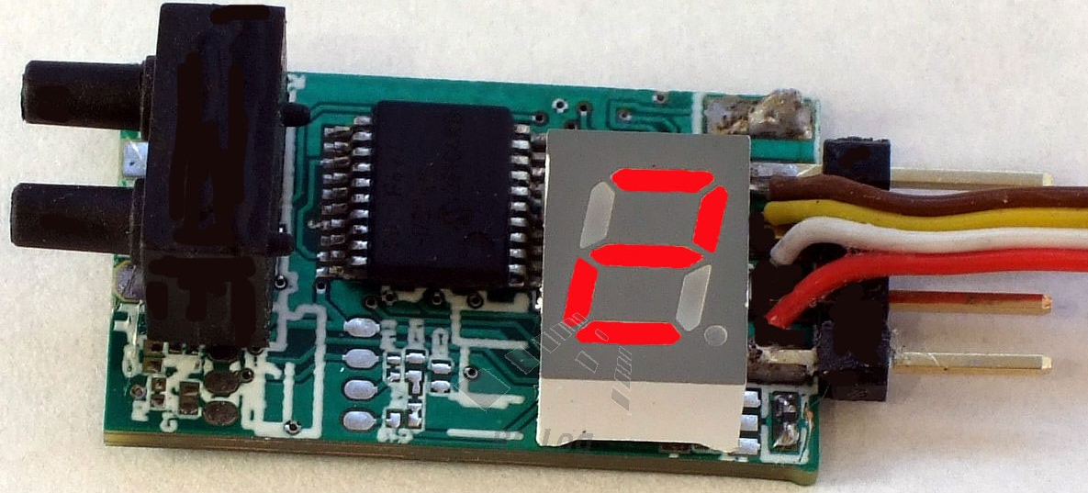
Eagle tree airspeed v3
Uses Prandtl style-static tube to measure airspeed of RPA
Maximum airspeed continuously updates on LED display
Connects directly to eLogger
Measures from 9 to 350 MPH
1 MPH resolution
Precalibrated
Circuit board: 0.15 oz, 1.1” x 0.62” x 0.4”
Pitot tube: 0.1 oz, 3.2” long, 0.16” diameter

Slide 6
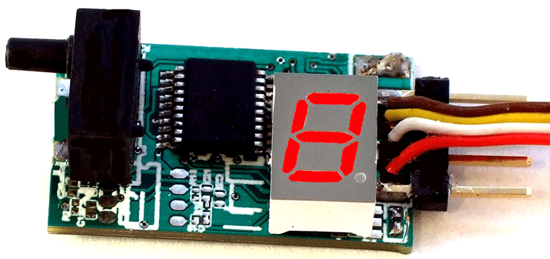
Eagle tree altimeter v4
Uses barometric pressure to measure RPA altitude during flight
Maximum altitude continuously updates on LED display
Connects directly to eLogger
Measures up to 20,000 ft above sea level
1 ft resolution
Precalibrated
0.15 oz, 1.1” x 0.62” x 0.4”

Slide 7
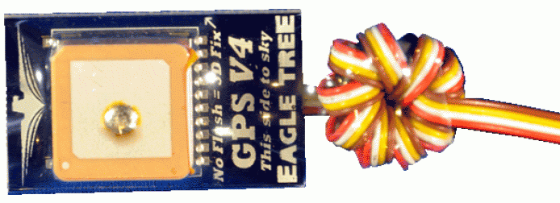
Eagle tree gps v4
Records GPS latitude/longitude, ground speed, altitude, and distance to pilot
Built-in LED display to indicate satellite 3D fix
Connects directly to eLogger
Update rate of 10Hz
Time to fix between 1 to 36 seconds
Resolution: 0.22 MPH (speed), 8.2 ft (position)
0.4 oz, 1.4” x 0.9” x 0.3”

Slide 8

Eagle tree POWER PANEL LCD
Programmable to display live and max flight data (Amps, Volts, mAH, Temperatures, RPM)
Supports multiple “virtual pages” to display parameters
Connects directly to eLogger
Up to 4 parameters can be displayed per “virtual page”
Display: 16 x 2 character LCD
0.5 oz, 2.5” x 1” x 0.19”

Slide 9
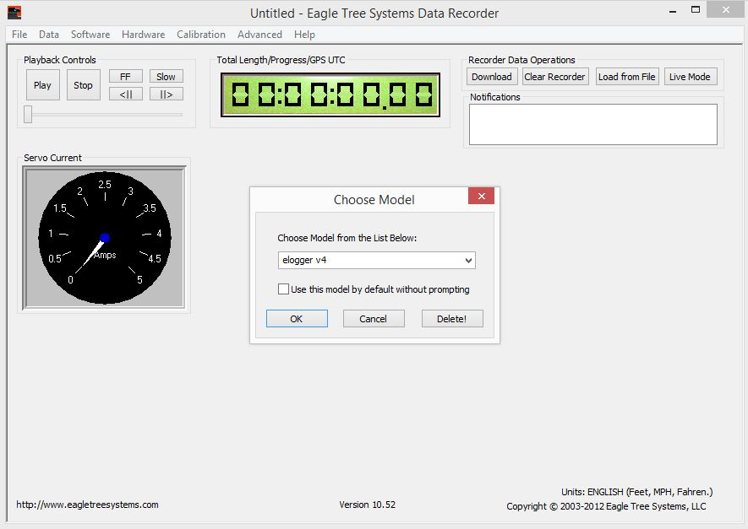
Eagle Tree systems Software
The eLogger can be directly connected to a PC to analyze recorded data
The latest software can be downloaded online at www.eagletreesystems.com
Support > Download Latest Software

Slide 10
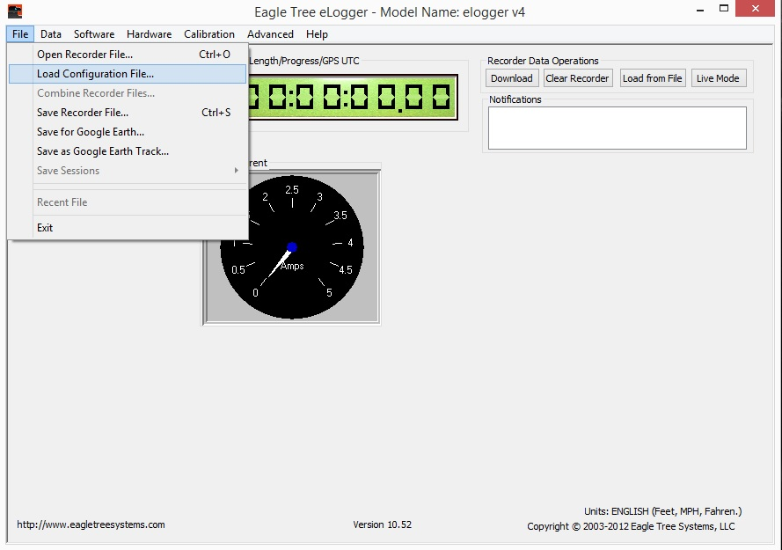
Eagle Tree systems Software
The flights are downloaded through the download button on the dashboard
With the eLogger connected you can open recorder files saved after each completed flight

Slide 11
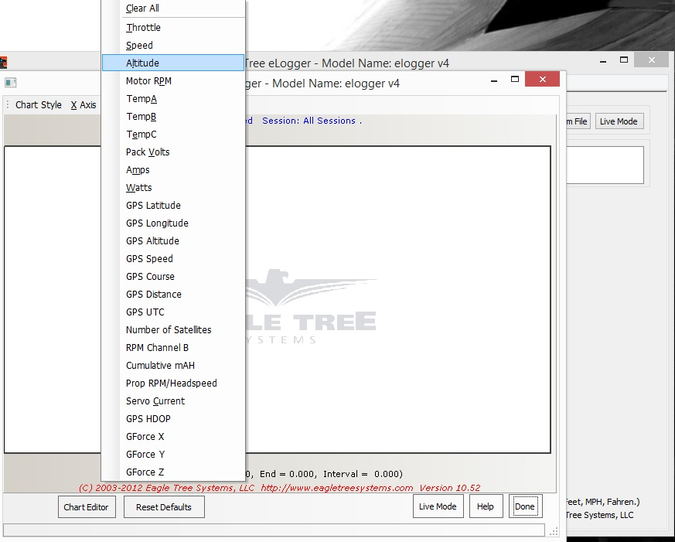
Eagle Tree systems Software
After loading, an output plot can easily be created to view the results
Option to select what to plot on each axis

Slide 12
Experimental results
To test out the avionics we took an eLogger and walked around the outside of ARMS
Connected an altimeter, airspeed, and GPS sensor to the eLogger

Slide 13
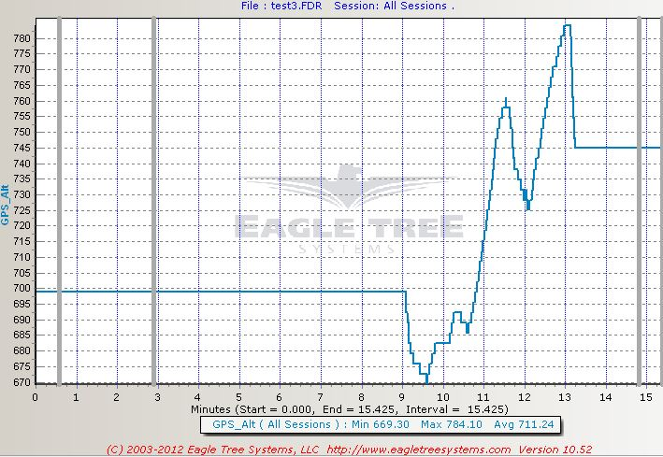
Experimental results: GPS alt

Slide 14
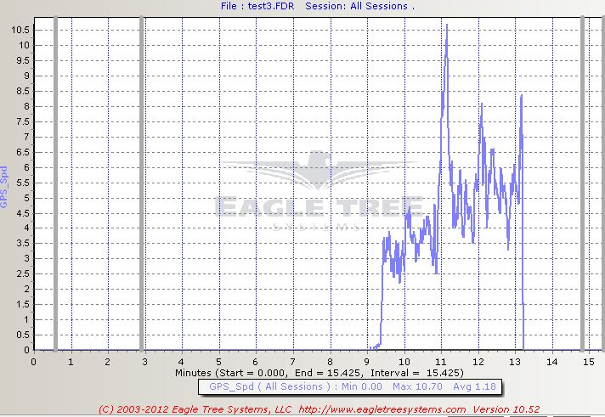
Experimental results: GPS vel

Slide 15
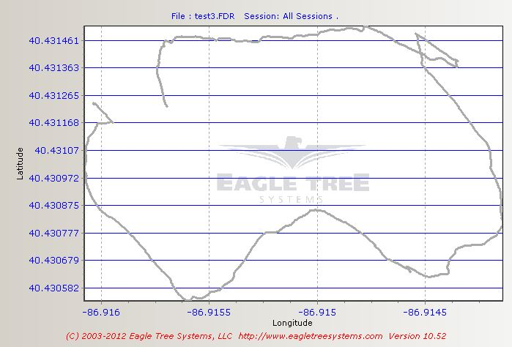
Experimental results: GPS lat/long

Slide 16
Questions?
Thank you!

